Slide 1
16.216
ECE Application Programming
Instructor: Dr. Michael Geiger
Fall 2013
Lecture 11
PE2: Loops and conditionals (continued)

Slide 2
Lecture outline
Announcements/reminders
  Program 2 regrades due today
  Program 4 posted; due 10/7
  Exam 1: Wednesday, 10/2
    Will be allowed one 8.5” x 11” double-sided note sheet
Today’s lecture
  Iterative methods (Program 4)
  Finish PE2: Loops
ECE Application Programming: Lecture 11

Slide 3
Iterative methods
Repeat calculation until correct value reached
“Correctness” defined as:
  Difference between old, new value <= max error
  Max error == .000001 in Prog. 4
General process:
newVal = <initial value>;
do {
oldVal = newVal;
newVal = <equation based on oldVal>;
} while (fabs(newVal – oldVal) > max_err);
Remember, you can’t use <math.h>, so you’ll need your own way of computing absolute value (fabs())
ECE Application Programming: Lecture 20

Slide 4
Today’s program should:
Prompt user to enter an input character and an integer, n.
  If not correctly formatted, print error, clear line, and repeat
Depending on the character entered, do the following:
  ‘F’ or ‘f’: Compute and print the factorial of n, n!
    For example, if the user enters F 5, print 5! = 120
  ‘P’ or ‘p’: Compute 2^{n}, but only if n >= 0.
    For example, if the user enters p 2, print 2^2 = 4
    Print an error if n < 0.
  ‘X’ or ‘x’: Exit the program
  In all other cases, print an error:
    For example: Invalid command Z entered
If the user enters any command other than ‘X’ or ‘x’, return to the initial prompt and repeat the program.
Will complete parts in red today
ECE Application Programming: Lecture 11

Slide 5
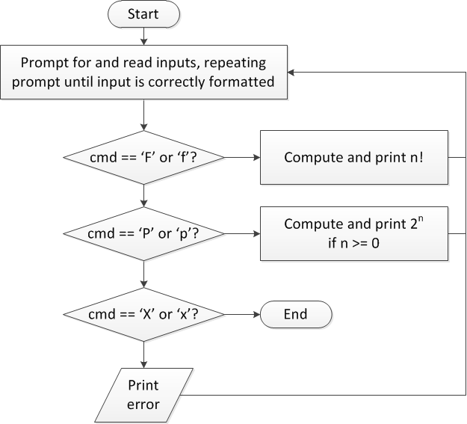
Flow charts: overall flow
ECE Application Programming: Lecture 11

Slide 6
Code: overall flow (skeleton code)
while (1) { // Loop repeats until user enters 'X' or 'x'
/* Code to read cmd, n */
/* Evaluate cmd and perform appropriate operation */
switch (cmd) {
case 'F':
case 'f':
/* Calculate n! */
break;
case 'P':
case 'p':
/* Calculate 2^n, if n >= 0; print error otherwise */
break;
case 'X':
case 'x':
return; // Exit program
default:
printf("Invalid command %c entered\n", cmd);
}
}
ECE Application Programming: Lecture 11

Slide 7
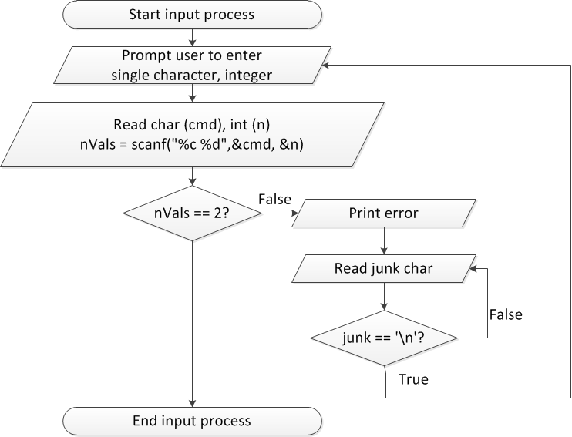
Flow charts: reading input
ECE Application Programming: Lecture 11

Slide 8
Discussion: Reading input
Loop that repeats as long as input incorrect
Loop inside that one to handle reading of remainder of line
  Read character until you reach end of line
Both while/do-while loops
ECE Application Programming: Lecture 11

Slide 9
Code: Reading input
do {
printf("Enter command and integer: ");
nVals = scanf("%c %d", &cmd, &n);
// Otherwise, print error & clear line
if (nVals != 2) {
printf("Incorrectly formatted input\n“);
do {
scanf("%c", &junk);
} while (junk != '\n');
}
} while (nVals != 2);
ECE Application Programming: Lecture 11

Slide 10
Next step
Write flowcharts for
  Computing n!
  Computing 2^{n} if n >= 0
Complete code
ECE Application Programming: Lecture 11

Slide 11
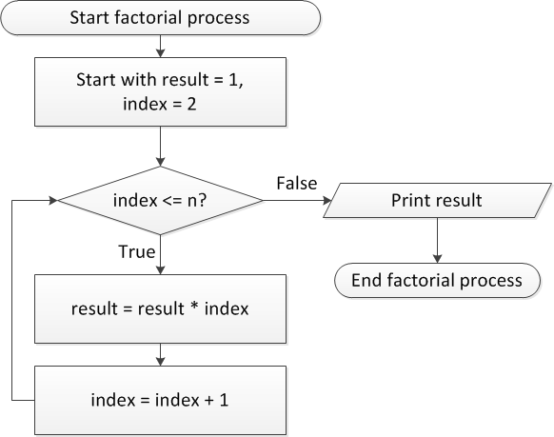
Flow charts: Calculating n!
ECE Application Programming: Lecture 11

Slide 12
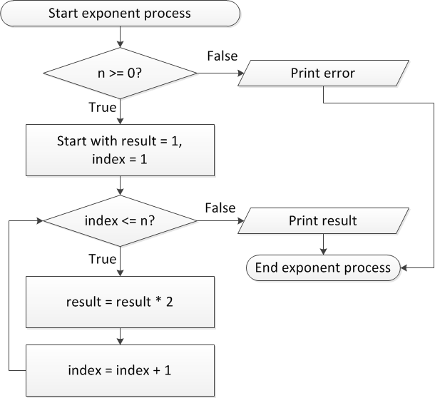
Flow charts: Calculating 2^{n}
ECE Application Programming: Lecture 11

Slide 13
Discussion: Factorial/2^{n}
Loop for each process covers fixed range of values
  Use for loop
Can declare single variable to hold both results, since only one will be calculated
ECE Application Programming: Lecture 11

Slide 14
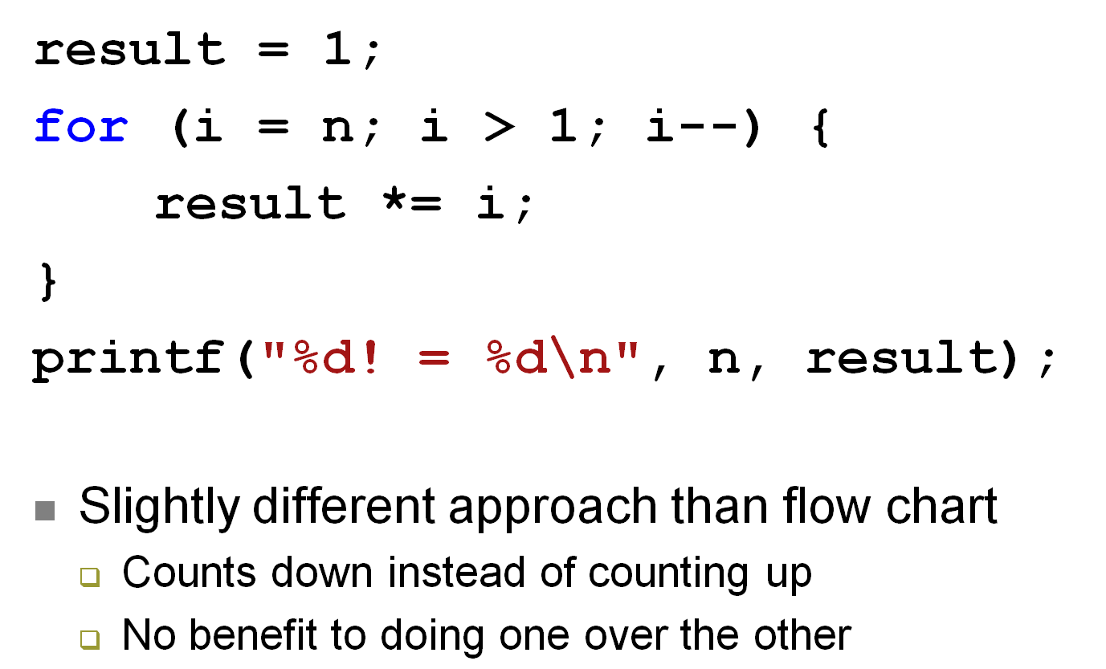
Code: factorial
ECE Application Programming: Lecture 11

Slide 15
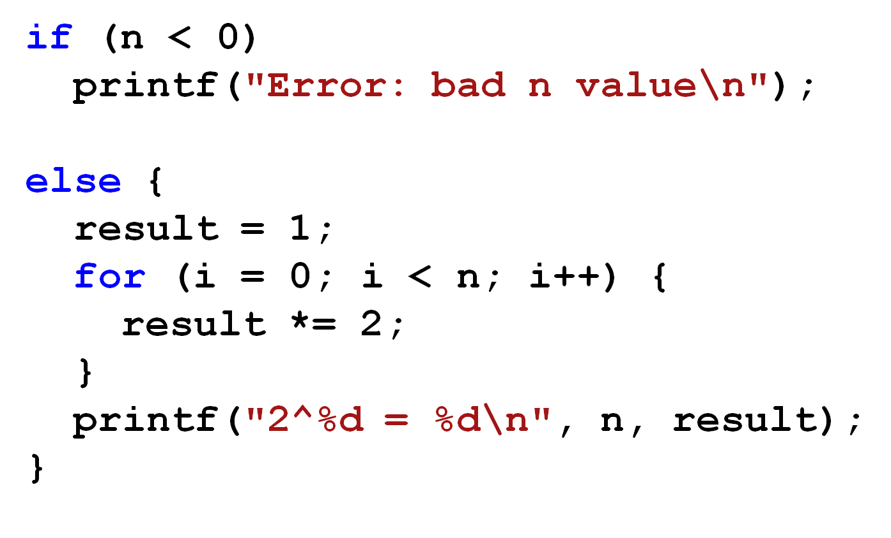
Code: 2^{n}
ECE Application Programming: Lecture 11

Slide 16
Final notes
Next time
  Finish PE2: Loops
Reminders:
  Program 2 regrades due today
  Program 4 posted; due 10/7
  Exam 1: Wednesday, 10/2
    Will be allowed one 8.5” x 11” double-sided note sheet
ECE Application Programming: Lecture 11

